Slide 1


You Shall Not (by)Pass!
Practical, Secure, and Fast PKU-based Sandboxing
Alexios Voulimeneas, Jonas Vinck, Ruben Mechelinck, Stijn Volckaert

Slide 2
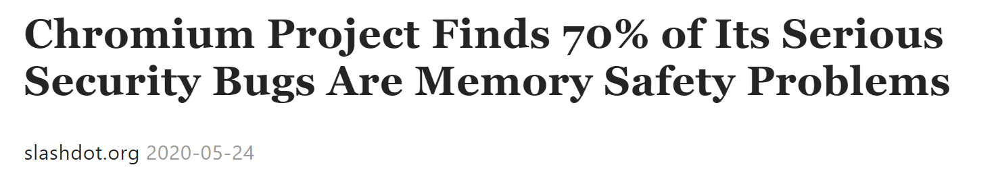
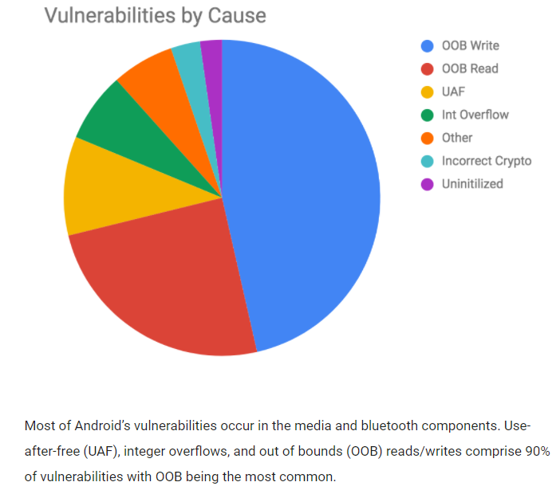
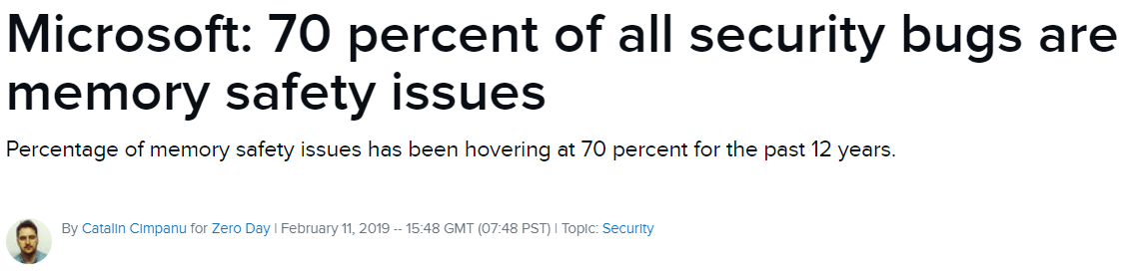


Slide 3
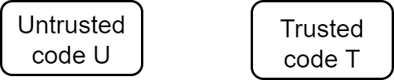
Compartmentalization

Slide 4
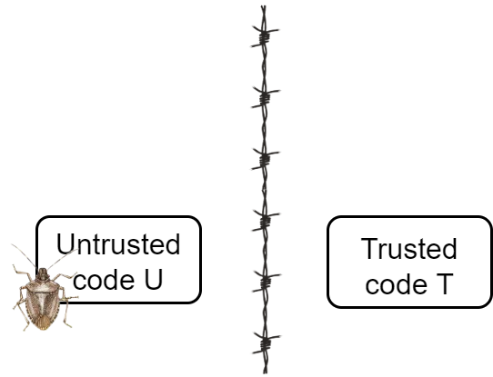
Compartmentalization

Slide 5
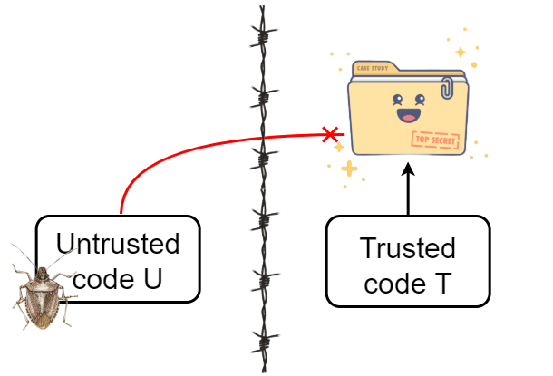

Compartmentalization

Slide 6

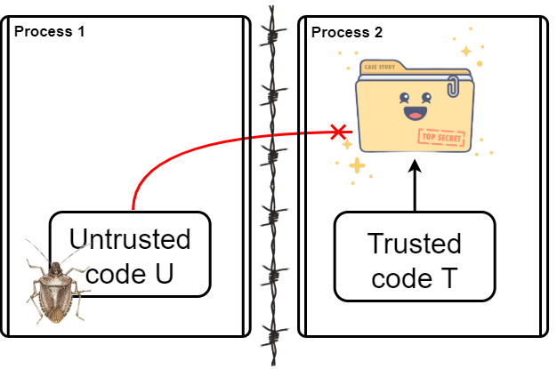


Process-Level Isolation
Enforced by the OS
Performance issues
Limited granularity
4

Slide 7

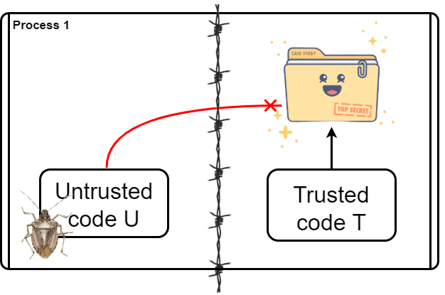
In-Process Isolation
Avoids (most) performance issues
Fine-grained isolation
Not enforced by the OS
4

Slide 8
In-Process Isolation (2)
Several techniques to enable in-process isolation
OS abstractions
Hardware virtualization support
ARM memory domains
Custom hardware
Supervisor Mode Access Prevention (SMAP)
Memory Protection Keys for Userspace (PKU)

Slide 9
Memory Protection Keys for Userspace (PKU)
Available on recent Intel and AMD server and desktop CPUs
Tag memory pages with one of 16 available protection keys (PKEYS)

Slide 10
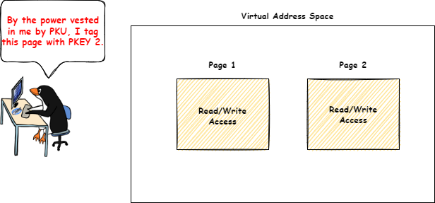
Memory Protection Keys for Userspace (PKU)
Available on recent Intel and AMD server and desktop CPUs
Tag memory pages with one of 16 available protection keys (PKEYS)

Slide 11
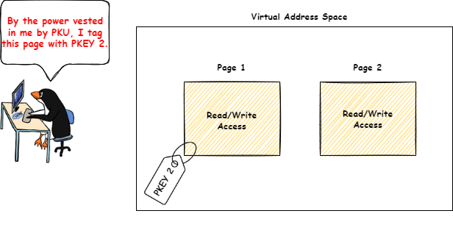

Memory Protection Keys for Userspace (PKU)
Available on recent Intel and AMD server and desktop CPUs
Tag memory pages with one of 16 available protection keys (PKEYS)

Slide 12
Memory Protection Keys for Userspace (PKU)
Available on recent Intel and AMD server and desktop CPUs
Tag memory pages with one of 16 available protection keys (PKEYS)
New unprivileged 32-bit register (PKRU)
PKRU Register
Protection Key | PKEY 15 |  |  | PKEY 2 |  | PKEY 1
Access/Write Disable | WD | AD | … | WD | AD | WD | AD
Bits | 0 | 0 |  | 0 | 0 | 0 | 0
PKEY 2 |  | PKEY 1 |  | PKEY 0
WD | AD | WD | AD | WD | AD
0 | 0 | 0 | 0 | 0 | 0

Slide 13
Memory Protection Keys for Userspace (PKU)
Available on recent Intel and AMD server and desktop CPUs
Tag memory pages with one of 16 available protection keys (PKEYS)
New unprivileged 32-bit register (PKRU)
Accessed with new instructions: wrpkru, rdpkru
Accessed with xrstor (if bit 9 of eax register is set)
PKRU Register
Protection Key | PKEY 15 |  |  | PKEY 2 |  | PKEY 1
Access/Write Disable | WD | AD | … | WD | AD | WD | AD
Bits | 0 | 0 |  | 0 | 0 | 0 | 0
PKEY 2 |  | PKEY 1 |  | PKEY 0
WD | AD | WD | AD | WD | AD
0 | 0 | 0 | 0 | 0 | 0

Slide 14

Memory Protection Keys for Userspace (PKU)
Available on recent Intel and AMD server and desktop CPUs
Tag memory pages with one of 16 available protection keys (PKEYS)
New unprivileged 32-bit register (PKRU)
Accessed with new instructions: wrpkru, rdpkru
Accessed with xrstor (if bit 9 of eax register is set)
PKRU Register
Protection Key | PKEY 15 |  |  | PKEY 2 |  | PKEY 1
Access/Write Disable | WD | AD | … | WD | AD | WD | AD
Bits | 0 | 0 |  | 0 | 0 | 0 | 0
PKEY 2 |  | PKEY 1 |  | PKEY 0
WD | AD | WD | AD | WD | AD
1 | 0 | 0 | 0 | 0 | 0

Slide 15
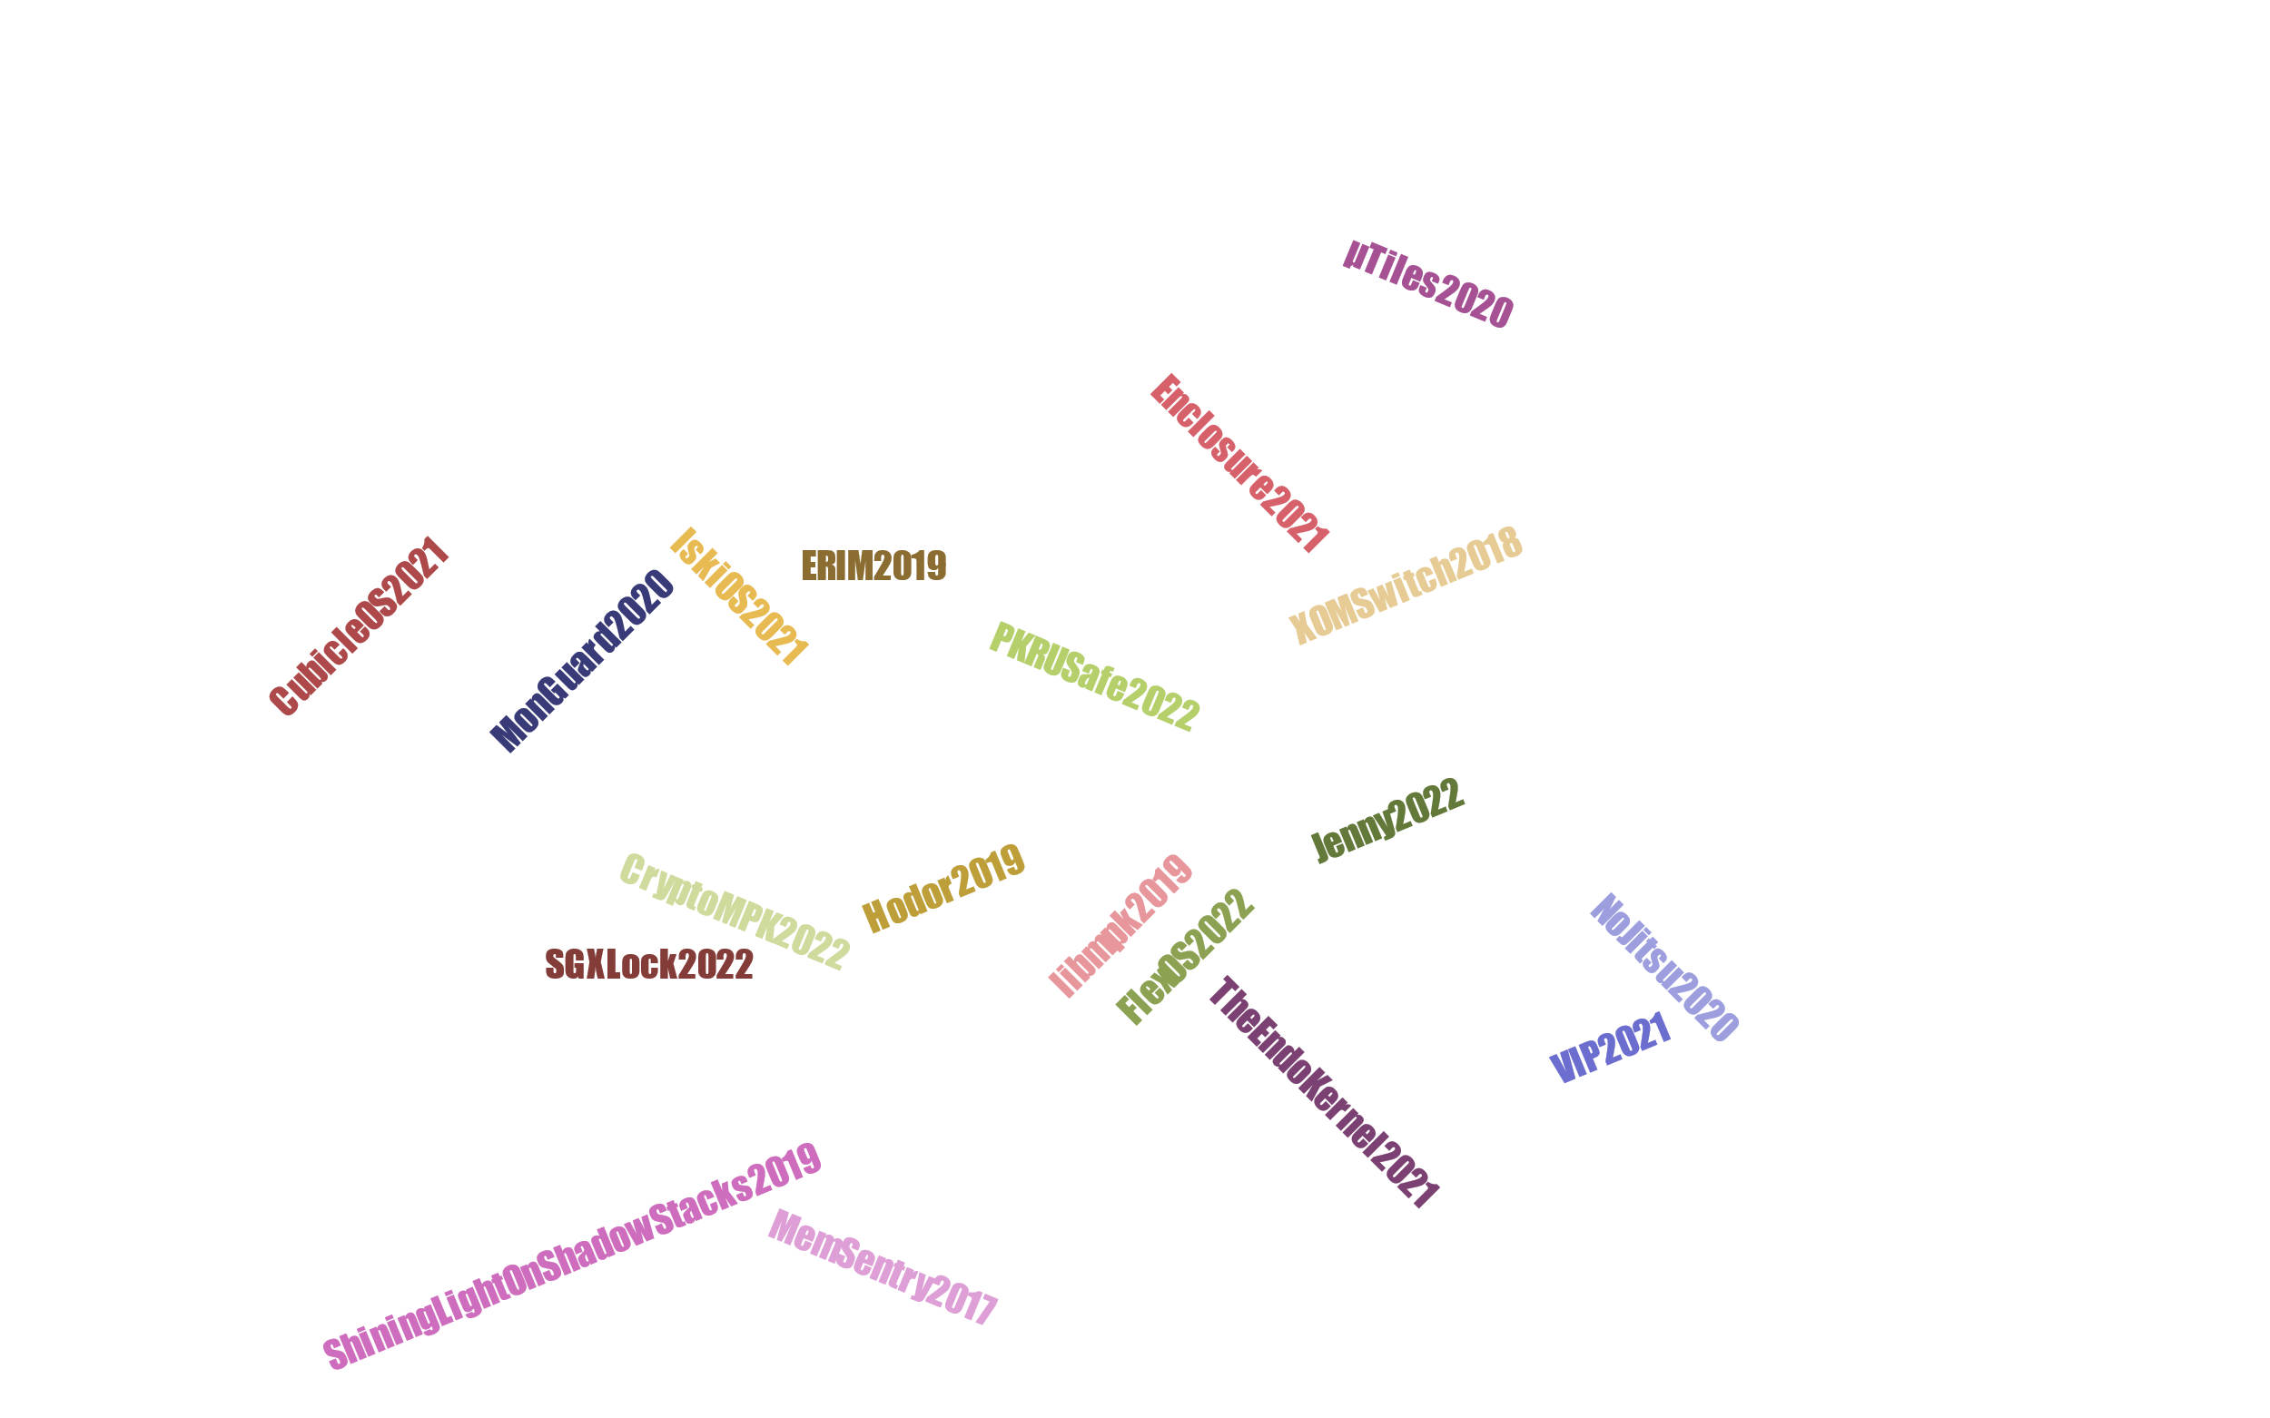

PKU-based Memory Isolation

Slide 16
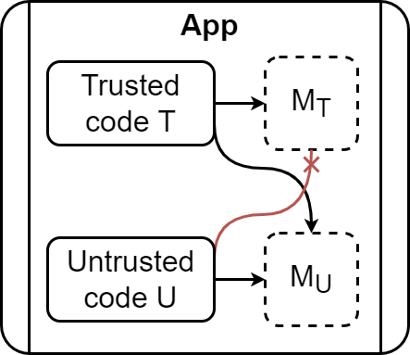
PKU-based Memory Isolation

Slide 17


PKU is Not Secure (On its Own)
Via exploitable wrpkru and xrstor instructions
(unsafe instructions)
PKRU is unprivileged
Attackers that hijack control flow can modify PKRU
Code may contain unsafe instructions
Attackers can introduce new unsafe instructions
Should be used in conjunction with other mitigations (e.g., CFI)

Slide 18
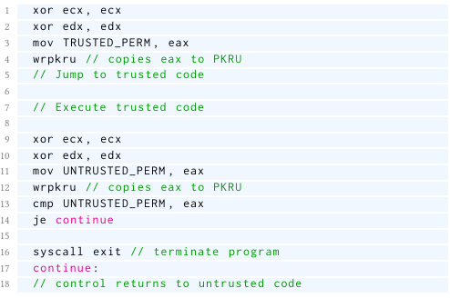
ERIM/Hodor
Compartmentalize applications
Two memory domains (M_{T} and M_{U})
Trusted (T) and untrusted (U) components
Transferring control from U to T or vice versa via exploit-proof call gates
ERIM’s call gate

Slide 19
ERIM/Hodor
Compartmentalize applications
Two memory domains (M_{T} and M_{U})
Trusted (T) and untrusted (U) components
Transferring control from U to T or vice versa via exploit-proof call gates
ERIM’s call gate

Slide 20
ERIM/Hodor
Compartmentalize applications
Two memory domains (M_{T} and M_{U})
Trusted (T) and untrusted (U) components
Transferring control from U to T or vice versa via exploit-proof call gates
ERIM’s call gate

Slide 21
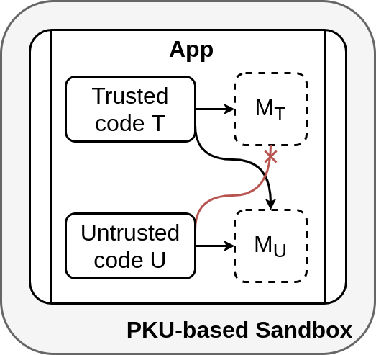
ERIM/Hodor
Eliminate unsafe instructions (ERIM)
Built-in PKU-based sandboxes
Scan new code for unsafe instructions
Mark pages containing unsafe instructions as non-executable (ERIM)
Leverage hardware breakpoints (Hodor)

Slide 22

Challenges of PKU-based Sandboxing
Handling of unsafe instructions
PKU Pitfalls (Conor et al. 2020)
Inconsistencies of PT and PKU permissions
Mappings with mutable backings
Changing code by relocation
Influencing intra-process behavior with seccomp
Modifying trusted mappings
Race conditions in scanning
Signal context attacks
New PKU Pitfalls
Vetted unsafe instruction relocation
Incomplete debug register update

Slide 23
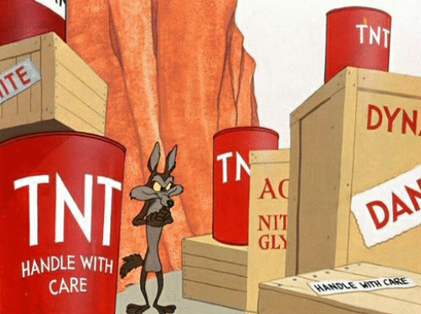
Handling of Unsafe Instructions

Slide 24

Handling of Unsafe Instructions
We examined Hodor^{[1]} and ERIM^{[2]}
Hodor’s sandbox does not vet xrstor instructions
ERIM’s sandbox marks pages containing unsafe instructions as non-executable (after using binary rewriting to eliminate unsafe instructions offline)
Works for old systems
Usability or security issues for recent systems
[1] https://github.com/hedayati/hodor [2] https://github.com/vahldiek/erim

Slide 25

PKU Pitfalls & New PKU Pitfalls

Slide 26
PKU Pitfalls
Attackers can circumvent page table and PKU permissions
process_vm* system calls
/proc/self/mem file
Attackers can change the virtual address space to access isolated memory or modify T (e.g., by invoking pkey_mprotect from U)
Attackers can modify executable mappings with mutable backings
Perform I/O operations on their mutable backing files
Abusing multiple mappings of the same shared memory
Connor et al. PKU Pitfalls: Attacks on PKU-based Memory Isolation Systems, USENIX Security, 2020

Slide 27
PKU Pitfalls (2)
Attackers can exploit the sandbox’s memory scanning
TOCTTOU race conditions
Inability of ptrace-based sandboxes to reliably identify the current executing domain
Bypass the sandbox and add unsafe
instructions to executable memory!
Connor et al. PKU Pitfalls: Attacks on PKU-based Memory Isolation Systems, USENIX Security, 2020

Slide 28

New PKU Pitfalls
Two new proof-of-concept attacks against PKU-based sandboxes
Vetted unsafe instruction relocation
Incomplete debug register update
They target Hodor’s instruction vetting mechanism
… but they can be generalized

Slide 29
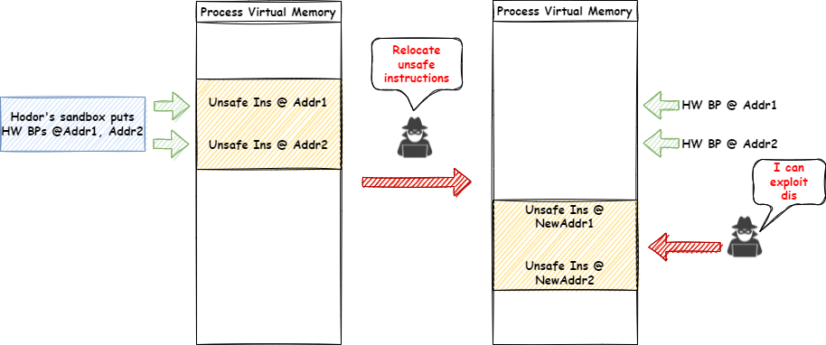
Vetted Unsafe Instruction Relocation

Slide 30
Vetted Unsafe Instruction Relocation

Slide 31
Vetted Unsafe Instruction Relocation

Slide 32
Vetted Unsafe Instruction Relocation

Slide 33
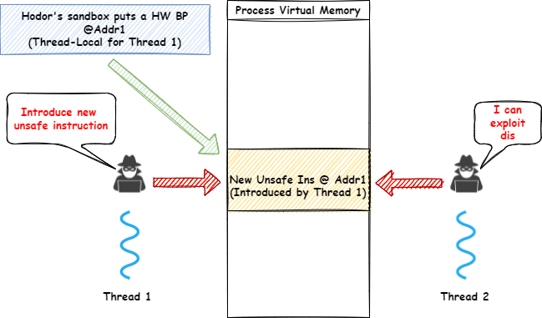
Incomplete Debug Register Update

Slide 34
Incomplete Debug Register Update

Slide 35
Incomplete Debug Register Update

Slide 36
Incomplete Debug Register Update

Slide 37

Introducing Cerberus
A Framework for PKU-based Sandboxing

Slide 38
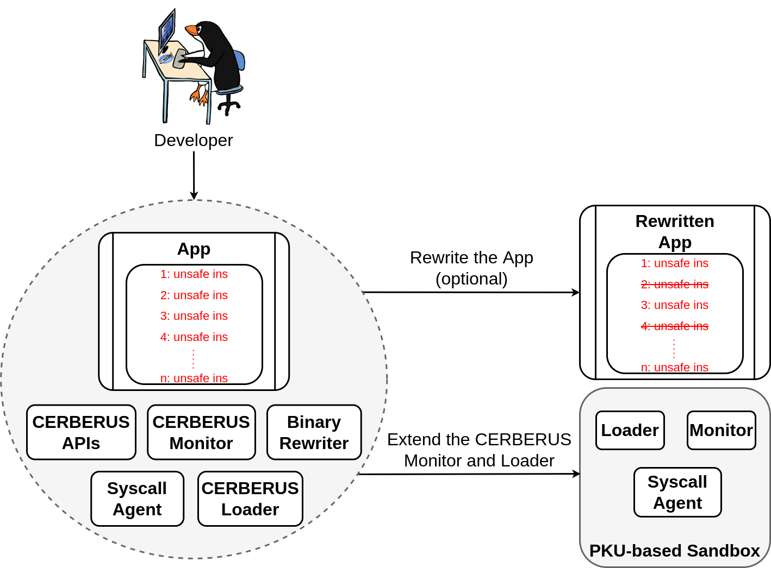
Cerberus’ Components

Slide 39
Cerberus’ Components

Slide 40
Cerberus’ Components

Slide 41
Cerberus’ Components

Slide 42
Cerberus’ Components

Slide 43
Cerberus’ Components

Slide 44
Cerberus’ Components

Slide 45
Cerberus’ Components

Slide 46
Basic PKU-based Sandbox
The monitor injects the loader into the application
The loader maps a special code page containing an rdpkru instruction
The loader initializes the syscall agent
Providing a list of system calls that should be monitored (SList)
Providing a list of sensitive files that should not be accessed (IList)
The loader completes application loading

Slide 47
Basic PKU-based Sandbox (2)
modify_ldt, prctl, seccomp, ptrace, process_
vm_readv, process_vm_writev, mprotect, pkey_-
mprotect, pkey_alloc, pkey_free, mmap, munmap, mremap, execve, shmat, shmdt, and all variants of the fork/clone system
"
The monitor uses the rdpkru instruction that the loader mapped to reliably determine the current executing domain
The syscall agent decides how system calls are dispatched
Forwards system calls included in SList to the monitor
Allows the rest to execute natively
The syscall agent blocks opening of sensitive files included in IList
The monitor blocks specific system calls from U
modify_ldt, prctl setting seccomp, seccomp, ptrace, pkey_alloc, pkey_free, pkey_mprotect, process_vm*, shmat and shmdt

Slide 48
Basic PKU-based Sandbox (3)
The monitor uses a modified version of Hodor’s instruction vetting scheme
Implemented in user space with ptrace
Vets both wrpkru and xrstor instructions
Intercepts and monitors system calls from U that could introduce unsafe instructions
Ensures that hardware breakpoints are properly updated when a process relocates code

Slide 49
Basic PKU-based Sandbox (4)
The monitor restricts or modifies mapped regions
Enforces W^X
Doesn’t allow PROT_EXEC && (MAP_SHARED | MAP_SHARED_VALIDATE)
Replaces the file-backed mappings with MAP_ANONYMOUS ones
Copies the file contents that the application initially attempted to map

Slide 50
Basic PKU-based Sandbox (5)
Protecting multi-threaded applications is challenging
Race conditions in memory scanning
Hardware breakpoints are thread local
We spawn a unique monitor for each application thread
We use locks to avoid race conditions in memory scanning
We augment hardware breakpoints with instruction emulation^{[1]}
[1] Vinck et al. Sharing is Caring: Secure and Efficient Shared Memory Support for MVEEs, EuroSys 2022

Slide 51

The Cerberus APIs
"
"
The monitor does not implement a mechanism to reliably track pages which are in M_{T}. Consequently, M_{T} is empty by default. The developer should use the Cerberus APIs to build such a mechanism
The monitor assumes that the application always executes code in U. The developer should use the Cerberus APIs to define the PKRU values that correspond to U and T respectively, and extend the monitor
"
The monitor considers all wrpkru and xrstor instructions as unsafe, except those included in a configurable list (AllowList). The AllowList is empty by default. The developer should use the Cerberus APIs to modify the AllowList

Slide 52

The Cerberus APIs (2)
Configuration of the syscall agent
Definition of U and T
Identification of the current executing domain
System call handling
Modification of the AllowList
Emulation engine

Slide 53
Implementation
≈11 KLOC (C/C++ and shell scripts)
Syscall agent is a small kernel patch for Linux 5.3
Implemented on top of related research projects^{[1,2]}
[1] Volckaert et al. Secure and efficient application monitoring and replication, USENIX ATC 2016 [2] Vinck et al. Sharing is Caring: Secure and Efficient Shared Memory Support for MVEEs, EuroSys 2022

Slide 54

Use Cases
PKU-based sandboxes for ERIM and XOM-Switch
ERIM’s sandbox implemented in ≈55 LOC of C/C++ code
XOM-Switch’s sandbox implemented in ≈16 LOC of C/C++ code

Slide 55
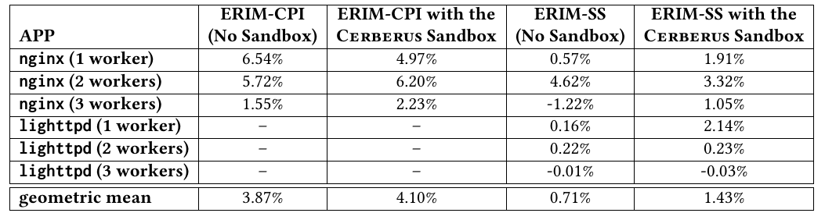
Performance Evaluation

Slide 56
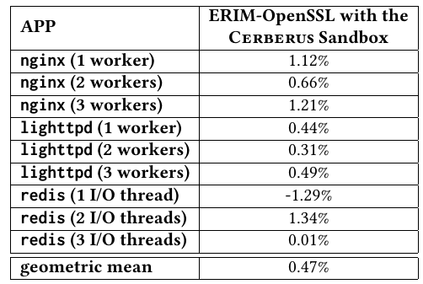
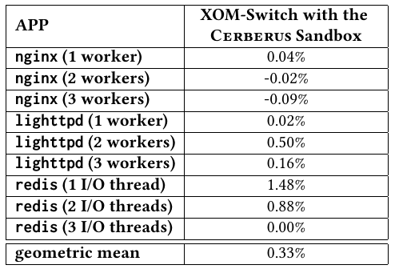
Performance Evaluation

Slide 57
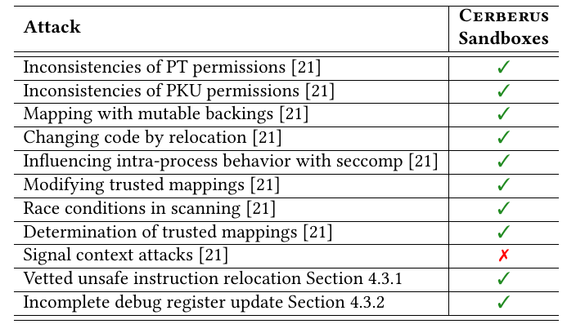
Security Evaluation
[21] Connor et al. PKU Pitfalls: Attacks on PKU-based Memory Isolation Systems, USENIX Security, 2020

Slide 58
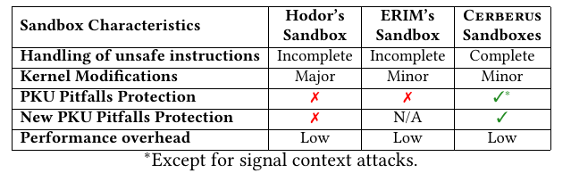
Comparison of PKU-based Sandboxes

Slide 59

Conclusion
Analysis of PKU-based sandboxing challenges
Known challenges
New challenges
Cerberus: A PKU-based sandboxing framework
Built sandboxes for ERIM and XOM-Switch
Evaluated the constructed sandboxes

Slide 60

Cerberus will be available soon!!! https://github.com/ku-leuven-msec/The-Cerberus-Project
Alexios Voulimeneas alex.voulimeneas@kuleuven.be twitter: @systemsgreek
Figure from teeturtle.com

